Slide 1
Data Structures and Algorithms (CCE 221)
By
Dr : Asmaa Aly Hagar

Slide 2
Course Academic Calendar
Week Num | Date | Content
Week1 | 24/9/2025 | Introduction to Data Structures + Mathematics Review + Review of Concepts of ‘C++’
Week2 | 01/10/2025 | Sparse Matrix, Concepts of Class, and Analysis of Algorithms
Week3 | 08/10/2025 | Linked Lists
Week4 | 15/10/2025 | Stack
Week5 | 22/10/2025 | Queue
Week6 | 29/10/2025 | Trees
Week7 | 05/11/2025 | Midterm
Week8 | 12/11/2025 | AVL Trees
Week9 | 19/11/2025 | Priority Queues and Heaps
Week10 | 26/11/2025 | Graph
Week11 | 03/12/2025 | Searching and Sorting
Week12 | 10/12/2025 | Hashing

Slide 3
Lecture4

Slide 4
Contents of the Lecture
What is a Stack?
How Stacks are used
Stack ADT
Operations on Stack
Stack Implementation
Stack Applications

Slide 5

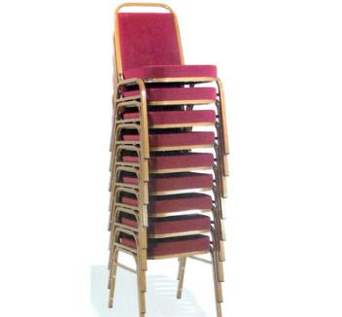
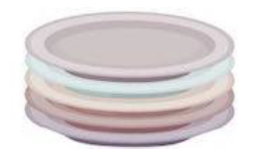
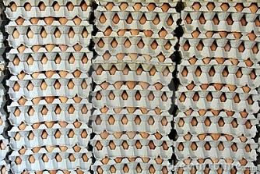

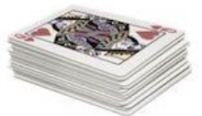
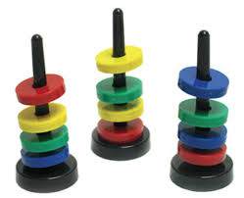
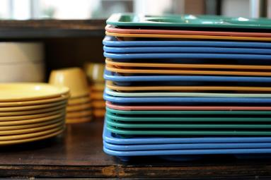
What is a Stack?

Slide 6
What is a Stack?
A stack is an Abstract Data Type (ADT), commonly used in most programming languages. It is named stack as it behaves like a real-world stack.
A stack is Linear - non-primitive data structure which follows the principle of LIFO (Last in First Out).
Stack is Ordered List of Elements of Same Type.
In a stack, the order in which the data arrives is important.
A stack is an ordered list in which insertion and deletion are done at one end, called top. The last element inserted is the first one to be deleted. Hence, it is called the Last in First out (LIFO) or First in Last out (FILO) list.

Slide 7
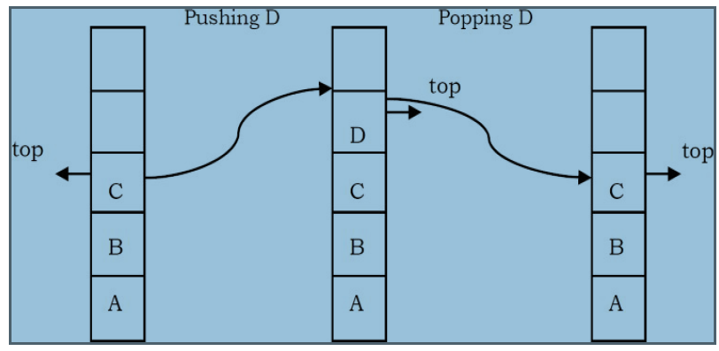
What is a Stack?
Special names are given to the two changes that can be made to a stack.
When an element is inserted in a stack, the concept is called push.
When an element is removed from the stack, the concept is called pop.
Trying to pop out an empty stack is called underflow, and trying to push an element in a full stack is called overflow. Generally, we treat them as exceptions.
As an example, consider the snapshots of the stack.

Slide 8
How Stacks are used
Consider a working day in the office. Let us assume a developer is working on a long-term project.
The manager then gives the developer a new task which is more important.
The developer puts the long-term project aside and begins work on the new task.
The phone rings, and this is the highest priority as it must be answered immediately.
The developer pushes the present task into the pending tray and answers the phone.
When the call is complete the task that was abandoned to answer the phone is retrieved from the pending tray and work progresses.
To take another call, it may have to be handled in the same manner, but eventually the new task will be finished, and the developer can draw the long-term project from the pending tray and continue with that.

Slide 9
Stack ADT
The following operations make a stack an ADT.
Main stack operations
    Push (int data): Inserts data onto stack.
    int Pop(): Removes and returns the last inserted element from the stack.
Auxiliary stack operations
    int Top(): Returns the last inserted element without removing it.
    int Size(): Returns the number of elements stored in the stack.
    int IsEmptyStack(): Indicates whether any elements are stored in the stack or not.
    int IsFullStack(): Indicates whether the stack is full or not.
Exceptions
    Attempting the execution of an operation may sometimes cause an error condition, called an exception. Exceptions are said to be “thrown” by an operation that cannot be executed.
    In the Stack ADT, operations pop and top cannot be performed if the stack is empty. Attempting the execution of pop (top) on an empty stack throws an exception.
    Trying to push an element in a full stack throws an exception.

Slide 10
Operations on Stack
Create the stack, leaving it empty.
Determine whether the stack is empty or not.
Determine whether the stack is full or not.
Push a new entry onto the top of the stack
Pop the entry off the top of the stack.

Slide 11
Operations on Stack
PUSH
  Is the process of adding (or inserting) new element to the top of the stack.
  After any push operation, the top pointer is incremented by one.
  If the stack is full no new element can be accommodated, then stack overflow condition occurs.
POP
  Is the process of deleting (or removing) an element from the top of the stack.
  After any pop operation, the top pointer is decremented by one.
  If there is no element on the stack and the pop operation is performed then stack underflow condition occurs.

Slide 12
Operations on Stack

Slide 13
Stack Implementation
There are many ways of implementing stack ADT; below are the commonly used methods.
    Simple array based implementation
    Dynamic array based implementation
    Linked lists implementation

Slide 14
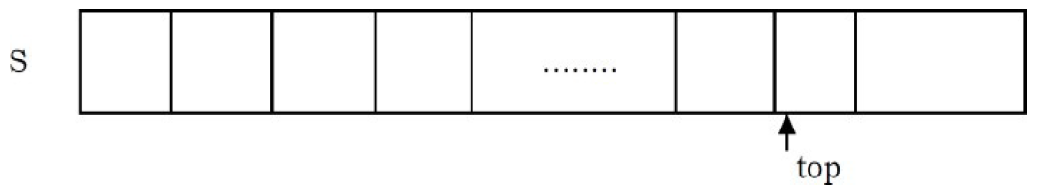
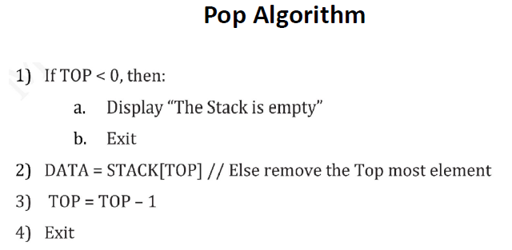
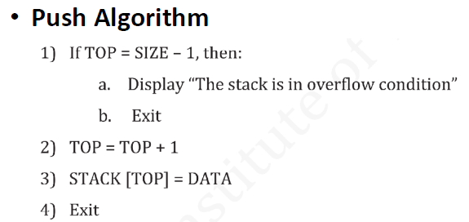
Simple Array Implementation
This implementation of stack ADT uses an array. In the array, we add elements from left to right and use a variable to keep track of the index of the top element.
The array storing the stack elements may become full. A push operation will then throw a full stack exception. Similarly, if we try deleting an element from an empty stack it will throw stack empty exception.
Suppose STACK[SIZE] is one dimensional array, TOP is the pointer to the top most element, and DATA be the data element.

Slide 15
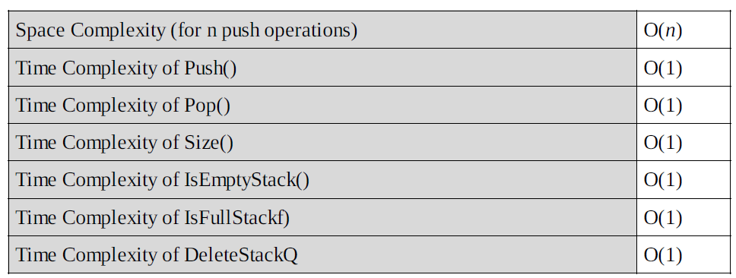
Performance & Limitations
Performance
Let n be the number of elements in the stack. The complexities of stack operations with this representation can be given as:
Limitations
The maximum size of the stack must first be defined and it cannot be changed. Trying to push a
new element into a full stack causes an implementation-specific exception.

Slide 16
Dynamic Array Implementation
First, let’s consider how we implemented a simple array based stack. We took one index variable top which points to the index of the most recently inserted element in the stack. To insert (or push) an element, we increment top index and then place the new element at that index. Similarly, to delete (or pop) an element we take the element at top index and then decrement the top index. We represent an empty queue with top value equal to –1.
The issue that still needs to be resolved is what we do when all the slots in the fixed size array stack are occupied?
First try:
What if we increment the size of the array by 1 every time the stack is full?
    Push(); increase size of S[] by 1
    Pop(): decrease size of S[] by 1

Slide 17
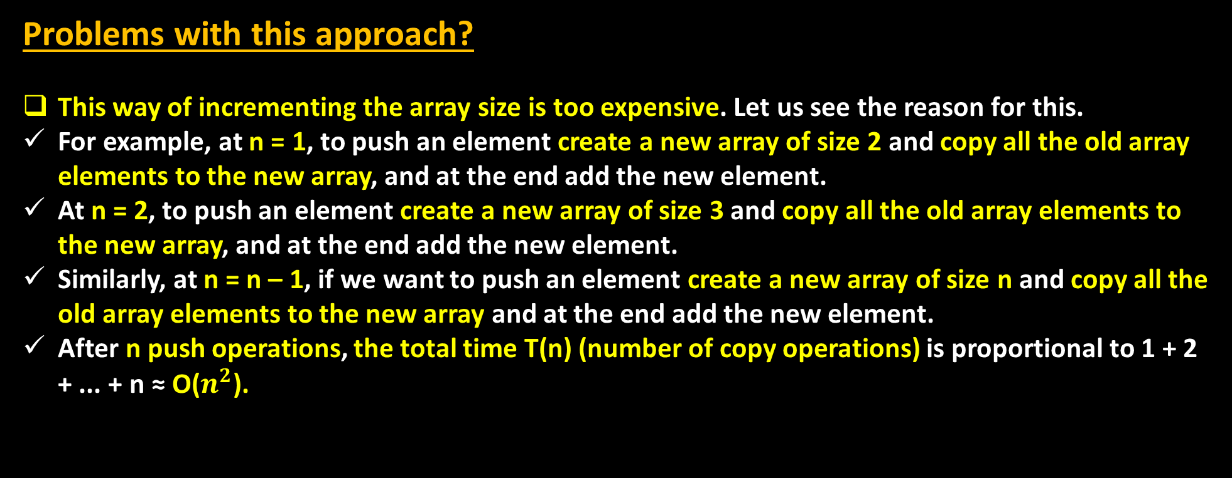
Dynamic Array Implementation
Problems with this approach?
This way of incrementing the array size is too expensive. Let us see the reason for this.
For example, at n = 1, to push an element create a new array of size 2 and copy all the old array elements to the new array, and at the end add the new element.
At n = 2, to push an element create a new array of size 3 and copy all the old array elements to the new array, and at the end add the new element.
Similarly, at n = n – 1, if we want to push an element create a new array of size n and copy all the old array elements to the new array and at the end add the new element.
After n push operations, the total time T(n) (number of copy operations) is proportional to 1 + 2 + ... + n ≈ O($n^{2}$).

Slide 18
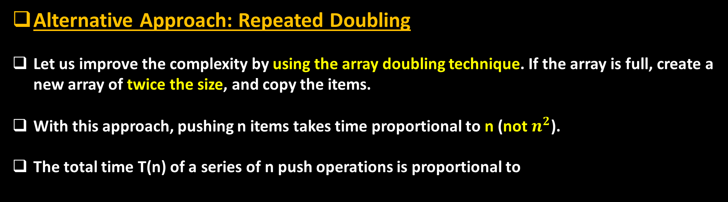
Dynamic Array Implementation
Alternative Approach: Repeated Doubling
Let us improve the complexity by using the array doubling technique. If the array is full, create a new array of twice the size, and copy the items.
With this approach, pushing n items takes time proportional to n (not $n^{2}$).
The total time T(n) of a series of n push operations is proportional to

Slide 19
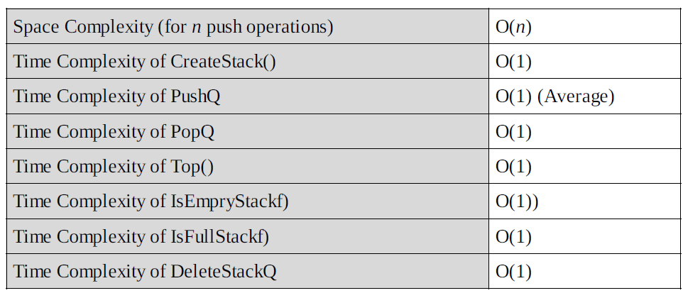
Performance
Let n be the number of elements in the stack. The complexities for operations with this representation can be given as:
Note: Too many doublings may cause memory overflow exception.

Slide 20
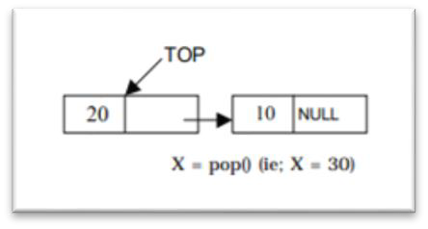
Linked List Implementation
The other way of implementing stacks is by using Linked lists. Push operation is implemented by inserting element at the beginning of the list. Pop operation is implemented by deleting the node from the beginning (the header/top node).

Slide 21
Linked List Implementation
Algorithm for PUSH Operation
Suppose TOP is a pointer, which is pointing towards the topmost element of the stack.
TOP is NULL when the stack is empty .
DATA is the data item to be pushed

Slide 22
Linked List Implementation
Algorithm for POP Operation
Suppose TOP is a pointer, which is pointing towards the topmost element of the stack .
TOP is NULL when the stack is empty .
TEMP is pointer variable to hold any nodes address.
DATA is the information on the node which is just deleted

Slide 23
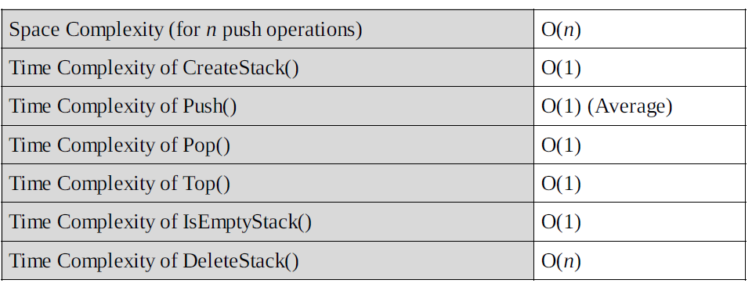
Performance
Let n be the number of elements in the stack. The complexities for operations with this representation can be given as:

Slide 24
Comparison of Implementations
Comparing Incremental Strategy and Doubling Strategy
We compare the incremental strategy and doubling strategy by analyzing the total time T(n) needed to perform a series of n push operations. We start with an empty stack represented by an array of size 1.
We call amortized time of a push operation is the average time taken by a push over the series of operations, that is, T(n)/n.
Incremental Strategy
The amortized time (average time per operation) of a push operation is O(n) [O(n^2)/n].
Doubling Strategy
In this method, the amortized time of a push operation is O(1) [O(n)/n].

Slide 25
Comparison of Implementations
Comparing Array Implementation and Linked List Implementation
Array Implementation
  Operations take constant time.
  Expensive doubling operation every once in a while.
  Any sequence of n operations (starting from empty stack) – “amortized” bound takes time proportional to n.
Linked List Implementation
Grows and shrinks gracefully.
Every operation takes constant time O(1).
Every operation uses extra space and time to deal with references.

Slide 26
Stack STL
STL
  Standard Template Library.
  It is a C++ library of container classes and algorithms.
  It provides many of the basic algorithms and data structures of computer science.
In order to create a stack in C++, we first need to include the stack header file.
  #include <stack>
  Syntax: stack<object_type> variable_name;
  Example: stack<int> s; OR stack<string> s;
  Functions in Stack:
  push() – to insert an element in the stack. s.push(110);
  pop() – deletes the last element of the stack. s.pop();
  top() – returns the element at the top of the stack. s.top();
  emplace() – to insert an element in the stack. s.emplace(1);
  size() – returns the number of elements on the stack. s.size();
  empty() – to check if the stack is empty or not. s.empty();

Slide 27
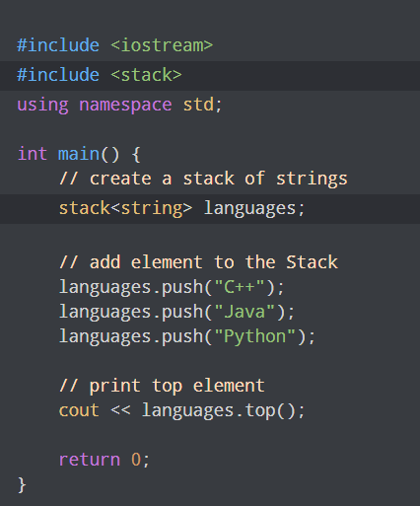
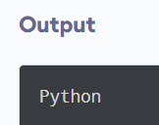
Stack STL Example

Slide 28
Stack Applications
Direct applications
    Evaluation of mathematical expressions in computers
    Function calls on compilers
    In balancing symbols
    In recursion functions
        Implementations of tower of Hanoi
        Factorial notation
        Fibonacci series
    Page-visited history in a Web browser [Back Buttons]
    Undo sequence in a text editor
    Matching Tags in HTML and XML
Indirect applications
    Auxiliary data structure for other algorithms (Example: Tree traversal algorithms)
    Component of other data structures (Example: Simulating queues {the next lecture})

Slide 29
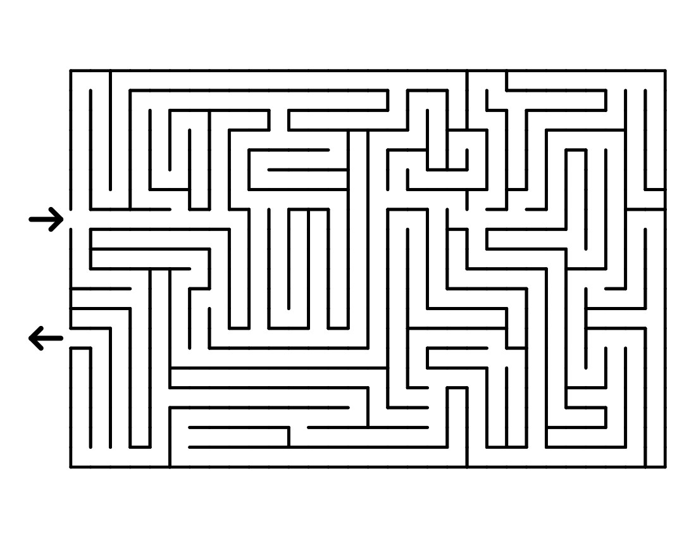

Undo operations and Backtracking

Slide 30
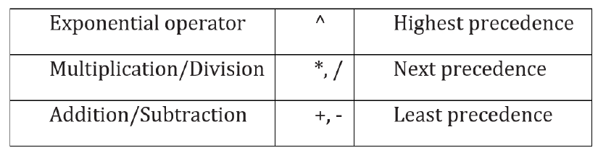
Mathematical Expression
Three types of mathematical expression notations
    Infix A+B
    Postfix AB+
    Prefix +AB
Humans use infix because it’s natural to read.
Computers prefer postfix or prefix because:
    No precedence rules required.
    No parentheses needed.
    Easy to evaluate with a stack.
In all notations, computations follow BODMAS rule:
Bracket, Order (root and power), Division, Multiplication, Addition, and Subtraction
Notation Conversions:
We can convert expressions from one notation, say, infix to other notations, say, prefix or postfix. Use BODMAS with the following rules.

Slide 31
Mathematical Expression
Converting Infix to Postfix Expression :
Rules:
Parenthesize the expression starting from left to right.
During parenthesizing the expression, the operands associated with operator having higher precedence are first parenthesized.
The sub expression (part of expression), which has been converted into postfix, is to be treated as single operand.
Once the expression is converted to postfix form, remove the parenthesis.

Slide 32
Mathematical Expression
Converting Infix to Postfix Expression :
Example: give the Postfix form for A + [ (B + C) + (D + E) * F ] / G
Solution: Evaluation order
= A + { [ (BC +) + (DE +) * F ] / G}
= A + { [ (BC +) + (DE + F *] / G}
= A + { [ (BC + (DE + F * +] / G}
= A + [ BC + DE + F *+ G / ]
= ABC + DE + F * + G / +, which is the Postfix Form

Slide 33
Mathematical Expression
Converting Postfix to Infix Expression :
Rules:
Start from the right most and scan for two consecutive operands.
Perform an operation using the previous nearest operator on the two operands, keeping their arrangement and in between.
Put the result (sub expression) in parenthesis and consider as a single operand.
Repeat (1) through (3).
Finally remove parenthesis when needed.

Slide 34
Mathematical Expression
Converting Postfix to Infix Expression :
Example: Give the Infix form of AB+C*D/EA^B/+
Solution:
= AB+C*D/(E^A)B/+
= AB+C*D/[(E^A)/B]+
= (A+B)C*D/[(E^A)/B]+
= [(A+B)*C]D/[(E^A)/B]+
= [[(A+B)*C]/D][(E^A)/B]+
= [[(A+B)*C]/D]+[(E^A)/B]
= (A+B)*C/D+E^A/B
, which is the Infix Form

Slide 35
Mathematical Expression
Converting Infix to Prefix Expression:
Rules:
Parenthesize the expression starting from left to right.
During parenthesizing the expression, the operands associated with operator having higher precedence are first parenthesized.
The sub expression (part of expression), which has been converted into prefix, is to be treated as single operand.
Once the expression is converted to prefix form, remove the parenthesis.

Slide 36
Mathematical Expression
Converting Infix to Prefix Expression:
Example: Give prefix form for A + [ (B + C) + (D + E) * F ] / G
Solution:
= A + [ (+BC) + (+DE) * F ] / G
= A + [ (+BC) + (*+DEF)] / G
= A +[++BC*+DEF] / G
= A +[/++BC*+DEFG]
= +A/++BC*+DEFG
, which is the Prefix Form

Slide 37
Mathematical Expression
Converting Prefix to Infix Expression
Rules:
Start from the left most and scan for two consecutive operands.
Perform an operation using the previous nearest operator on the two operands, keeping their arrangement and in between.
Put the result (sub expression) in parenthesis and consider as a single operand.
Repeat (1) through (3).
Finally remove parenthesis when needed.

Slide 38
Mathematical Expression
Converting Prefix to Infix Expression
Example: Give Infix form for +A/++BC*+DEFG
Solution:
= +A/+(B+C)*+DEFG
= +A/+(B+C)*(D+E)FG
= +A/+(B+C)[(D+E)*F]G
= +A/((B+C)+[(D+E)*F])G
= +A[((B+C)+[(D+E)*F])/G]
= A+[((B+C)+[(D+E)*F])/G]
= A+[(B+C)+(D+E)*F]/G
, which is the Infix Form

Slide 39
Mathematical Expression
Converting Prefix to Postfix Expression and Vice versa:
This can be done directly and indirectly.
Indirectly
Prefix to Postfix: First convert from prefix into infix and then to postfix.
Postfix to Prefix: First convert from postfix into infix and then to prefix.
Directly
Prefix to Postfix: Follow the same rule as converting prefix to infix except the converted expression in into postfix.
Postfix to Prefix: Follow the same rule as converting postfix to infix except the converted expression in into prefix.

Slide 40
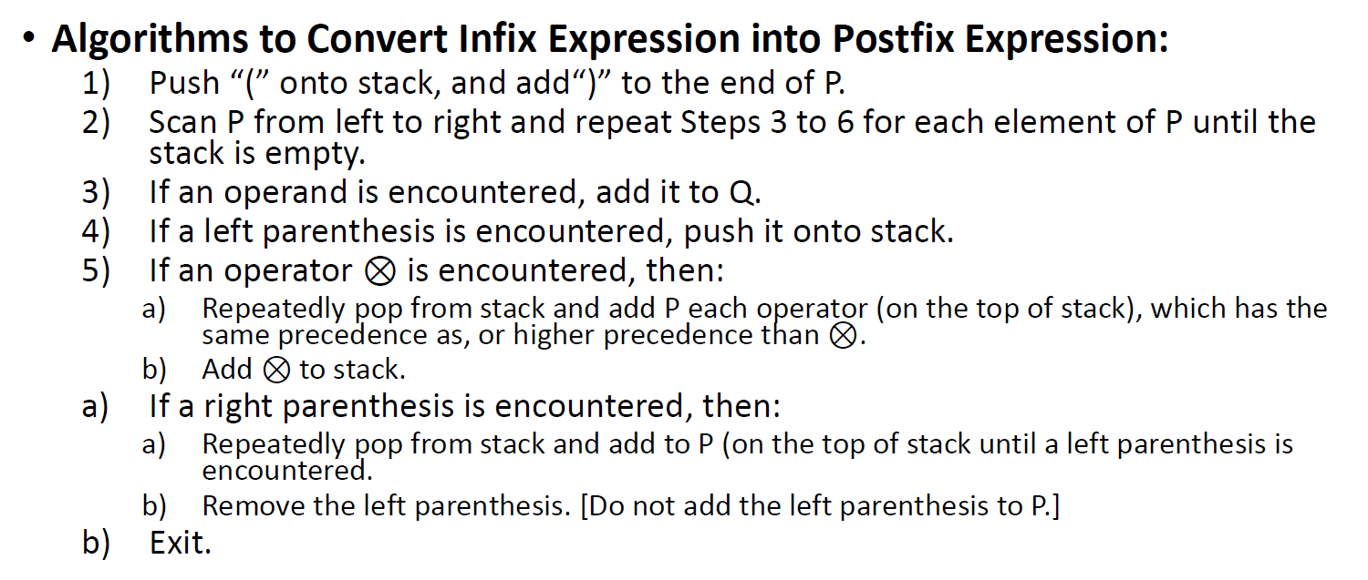
Algorithm to Convert Infix → Postfix

Slide 41
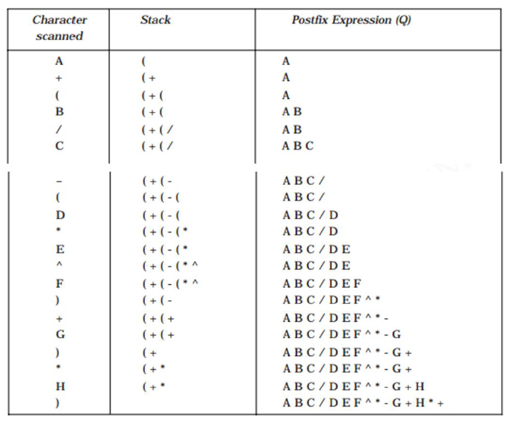
Algorithm to Convert Infix → Postfix
Example: A+(B/C-(D*E^F)+G)*H)

Slide 42
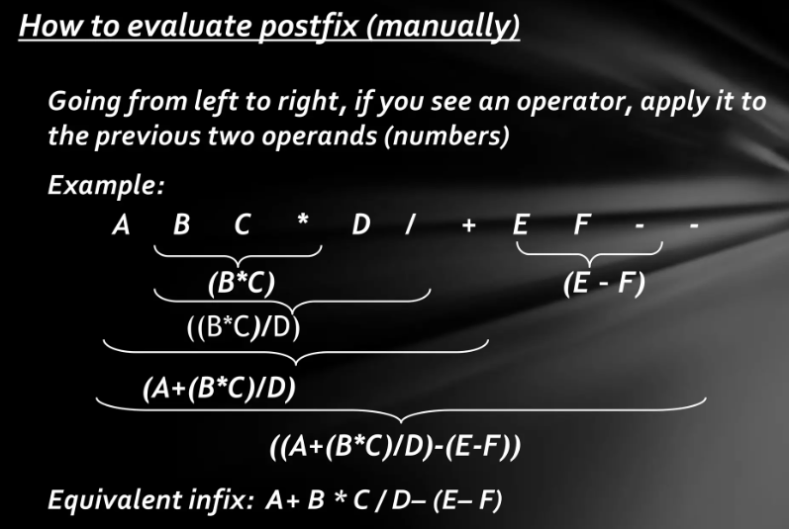
Evaluate Postfix Expression Manually

Slide 43
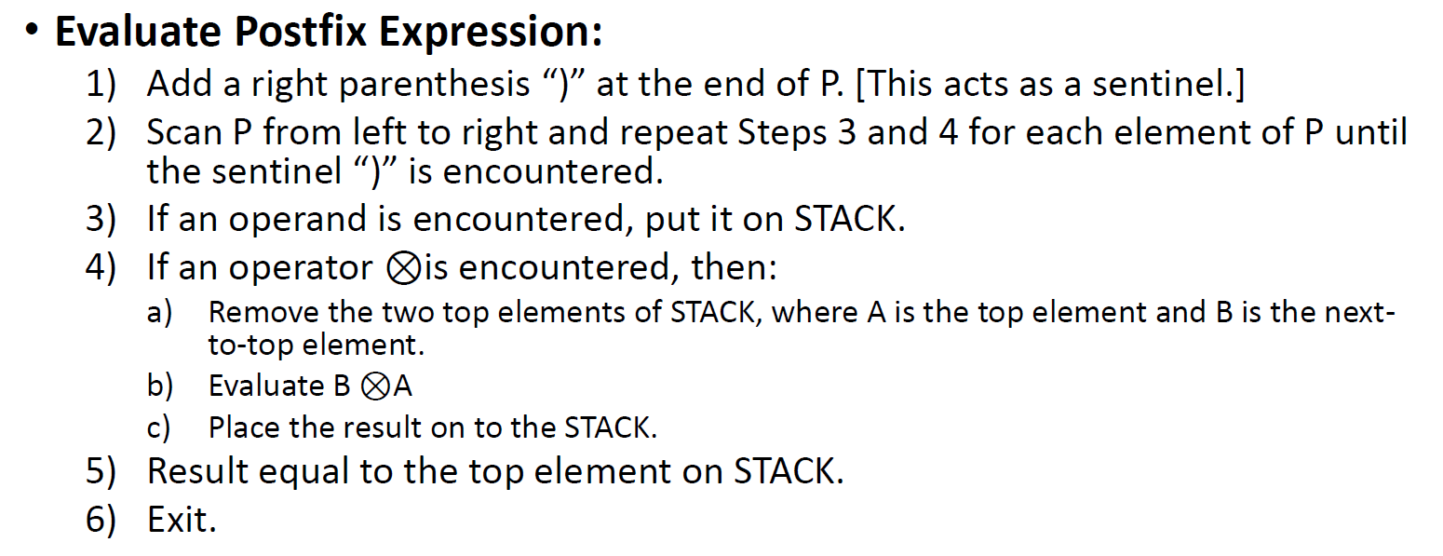
Algorithm to Evaluate Postfix Expression

Slide 44
Algorithm to Evaluate Postfix Expression
Example: 4 3 * 6 7 + 5 - +)
PUSH 4
PUSH 3
POP 3
POP 4
PUSH 12
PUSH 6
PUSH 7
POP 7
POP 6
PUSH 13
PUSH 5
POP 5
4
3
4
4
12
6
12
7
6
12
6
12
12
13
12
5
13
12
13
12
* => POP 3 & POP 4 => 3*4=12 => PUSH 12 IN STACK
+ => POP 7 & POP 6 => 6+7=13 => PUSH 13 IN STACK
- => POP 5 & POP 13 => 13-5=8 => PUSH 8 IN STACK

Slide 45
Example: 4 3 * 6 7 + 5 - +)
POP 13
PUSH 8
POP 8
POP 12
PUSH 20
PUSH 8
12
8
12
12
20
20
+ => POP 8 & POP 12 => 8+12=20 => PUSH 20 IN STACK
=> POP 20 => Result = 20

Slide 46
Function calls on compilers => Call Stack
On calling a function, it is important to save the address of next instruction that needs to be executed in the program.
For saving a return address, it needs to be put somewhere in the memory.
The conventional method is to push in to the stack.
Also, a function needs to save the parameters before executing its instructions, which will also be pushed in the stack.
This forms the call stack.

Slide 47
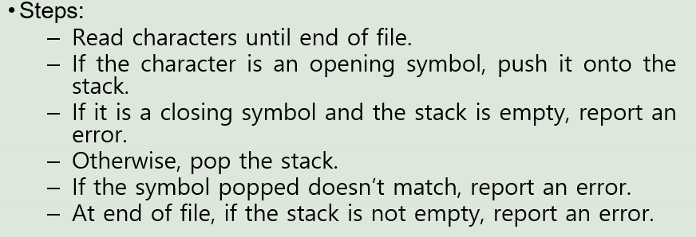
Balancing Symbols
Stack is used for balancing symbols on mathematical expressions, etc.
Compilers check a programs for syntax errors, but frequently a lack of one symbol (such as a missing brace or comment starter) will cause the compiler to spill out a hundred lines of diagnostics without identifying the real error.
    A useful tool in this situation is a program that checks whether everything is balanced.
    Thus, every right brace, bracket, and parenthesis must correspond to their left counterparts.
    The sequence [()] is legal, but [(]) is wrong.

Slide 48
Recursion Functions
Recursion occurs when a function is called by itself and the function is called a recursive function.
Recursion is very different from iteration.
  Because, iteration is repeating same program many times until a condition occurs.
Stack is used to implement applications that uses recursion functions
    Tower of Hanoi
    Factorial
    Fibonacci Series

Slide 49
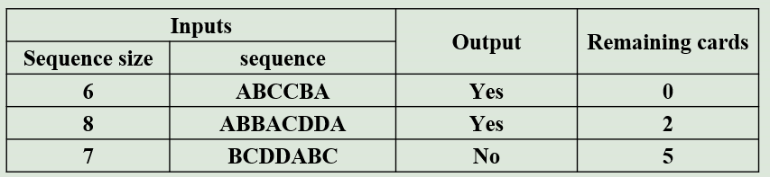
Problem
A player is playing a card game where he draws cards from a pile. He can draw one card each round and the card is placed on top of an initially empty pile. If the card he draws matches the card at the top of the pile, both cards are discarded. The player wins if he has three cards or less left in his pile. Write a C++ program that takes the number of cards the player draws and a sequence of letters representing each card. The output of the program should be whether the player won or lost. Use the appropriate data structure. The following are example test cases

Slide 50


